Slide 1
Project:
MealMate
Subject: CS691
Computer Science
Project 1

Slide 2

Agenda
The Objective of this meeting is to give an overview of the Project
The aim of this meeting is to evaluate our progress towards meeting deadlines, ensure alignment on our advancements, tackle any obstacles, and coordinate our next steps regarding development.
We will discuss the importance of submitting deliverables on time, marking significant dates, and incorporating them into a shared calendar.
Topics for the presentation will be deliberated upon, and the presentation will undergo iterative updates.
We will verify the requirements from the client's perspective, considering aspects such as personas and all project necessities.
Risk assessment will be a topic of discussion.
Active participation, attendance, cooperation, teamwork, and attention from each team member are essential for the project's success.

Slide 3
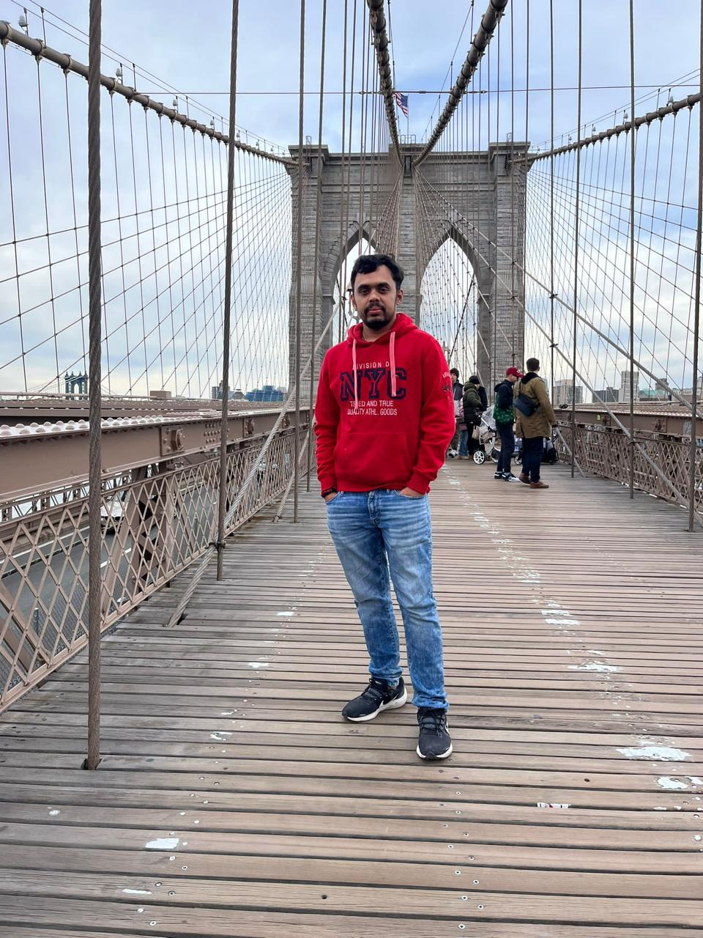
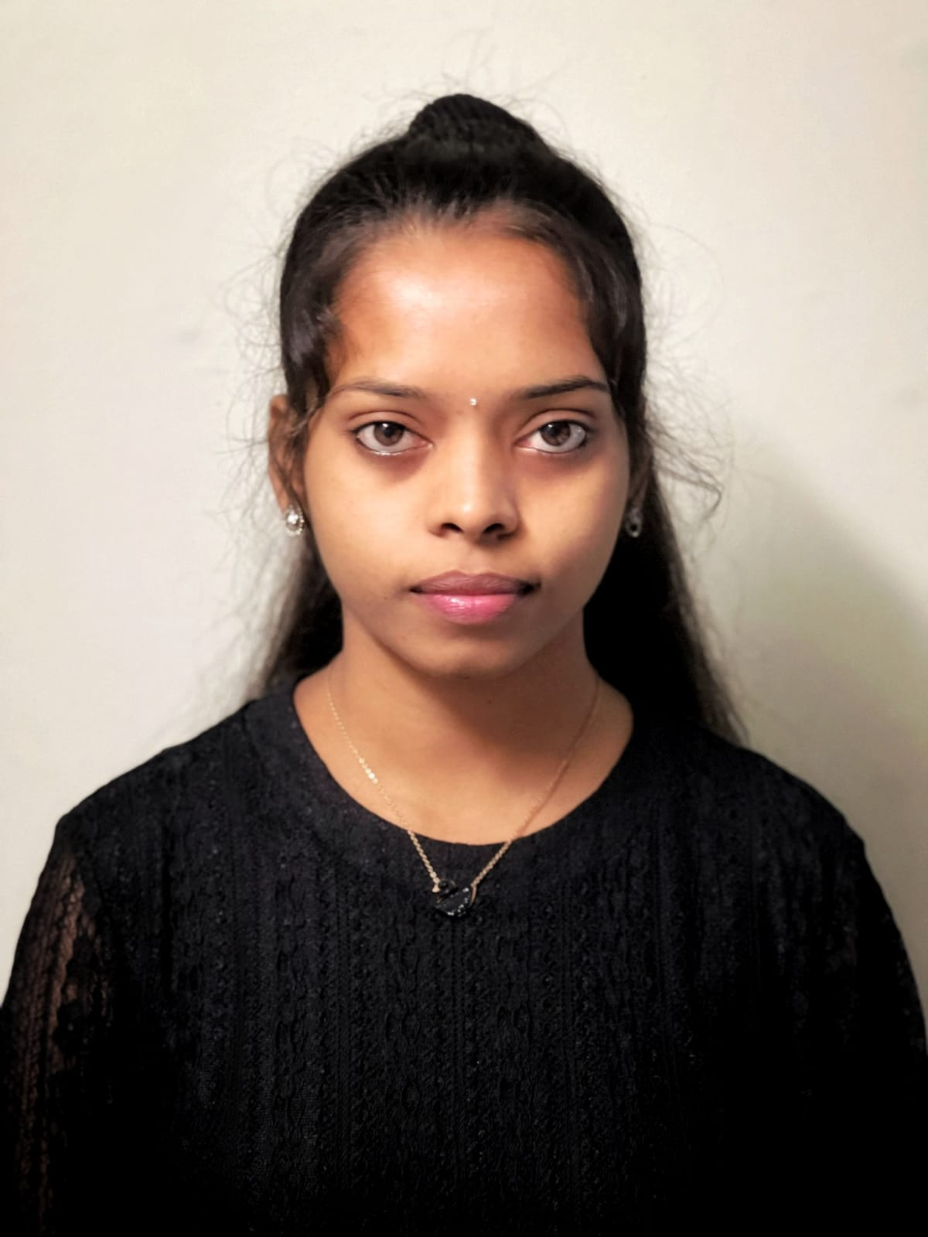


Team Members Roles
Sarath Upadrista
Full Stack Developer and Devops
Archana
Project Manager
Quality Analyst & Tester
Dharavath, Harika
Mobile Application Developer and UI/UX

Slide 4
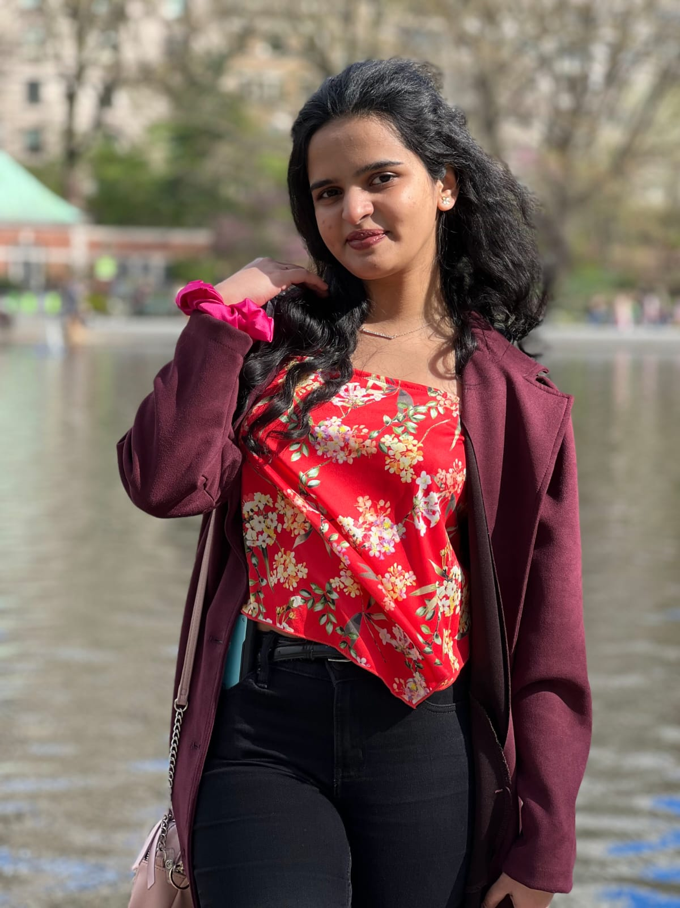
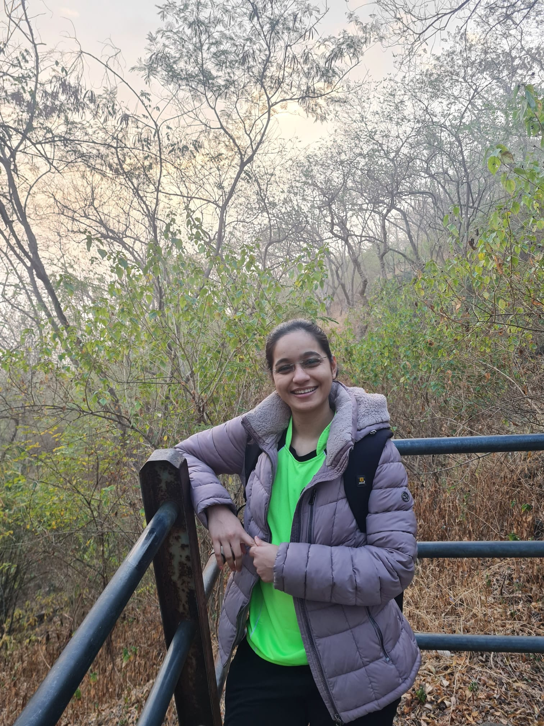
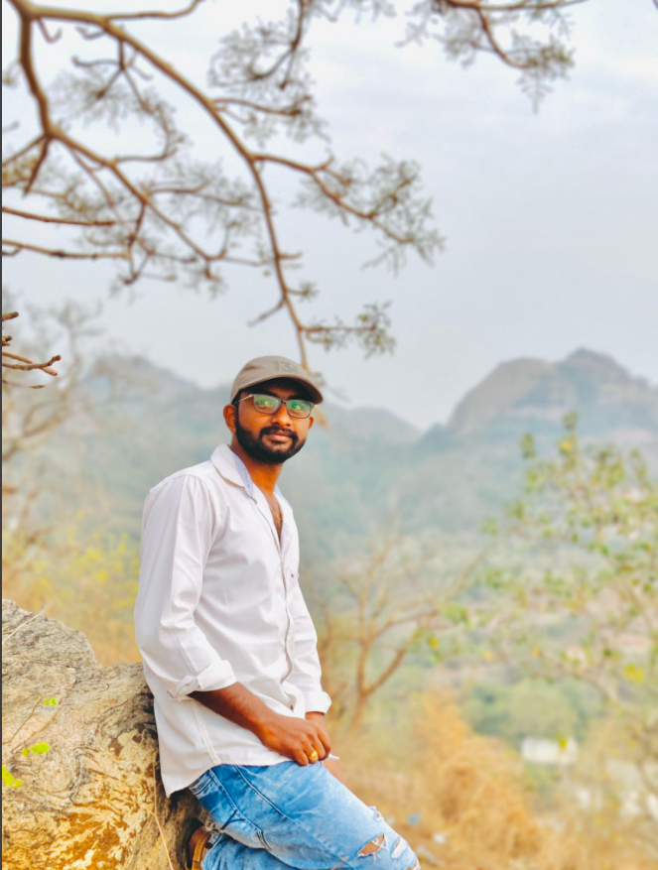
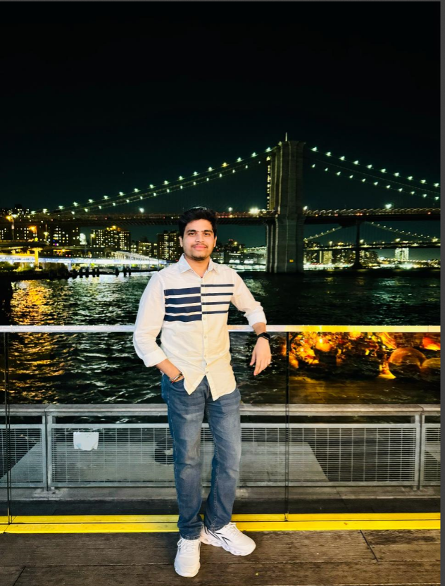
Team Members Roles
Pavan
Cloud Engineer and Developer
Avhad, Dipali Vijay
Developer and tester
Kundan Sai Datta Prasad,Gowru
Backend Developer and DevOps

Slide 5
Improvements made from Professor's Feedback
Post the deliverable 1 presentation, we received feedback from the professor on adding the personas and making few changes in our retrospective section which we did accordingly which can be seen in the further slides.

Slide 6

Problem statement
These days, people who live alone or with their families often struggle with planning meals. It can be tough to decide what to cook, especially when you have lots of different vegetables at home. You have to check what veggies you have before you can pick a recipe. So, figuring out meals can take a lot of time and effort. People find it hard because they have to think about what everyone likes to eat and what's healthy too. Sometimes, it feels like a big job just to get dinner ready. So, meal planning can be a bit of a hassle for many folks.

Slide 7

project Description
Introducing the "Meal Mate" web app – your new kitchen companion! Our goal is to make meal planning easier and more fun using the latest technology. With our app, all you have to do is snap a picture of the veggies you have, and we'll do the rest! Using smart image processing, we'll suggest recipes just for you based on what's in your kitchen. Say goodbye to the hassle of deciding what to cook and hello to delicious meals tailored to your ingredients. "MealMate" promises to make cooking simpler and more enjoyable for everyone.

Slide 8

Personas

Slide 9

Persona 1
Profile:
Sarah is a busy marketing executive who often struggles with meal planning due to her demanding job. She enjoys cooking but finds it challenging to make time for it amidst her busy schedule.
Interests:
Sarah enjoys experimenting with new recipes and flavors when she has the time. She is interested in maintaining a healthy lifestyle but struggles to find the time to plan and prepare nutritious meals.
Frustration:
Sarah is frustrated by the lack of time she has to plan and prepare meals, often resorting to unhealthy takeout options due to her busy schedule.
Goals:
Sarah's goal is to find a convenient solution for meal planning that fits into her busy lifestyle. She wants a tool that can help her quickly and easily plan nutritious meals using the ingredients she already has at home.
Demographics:
Name: Sarah Age: 32 Occupation: Marketing Executive

Slide 10
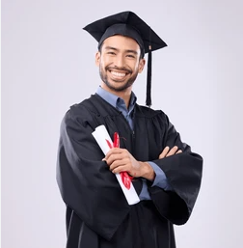
Persona 2
Profile:
Michael is a recent college graduate who has just moved into his first apartment. He is eager to learn how to cook but feels overwhelmed by the variety of ingredients available at the grocery store.
Interests:
Michael is interested in learning how to cook simple and nutritious meals that he can enjoy at home. He wants to improve his culinary skills and become more confident in the kitchen.
Frustration:
Michael is frustrated by his lack of experience in the kitchen and feels overwhelmed by the prospect of cooking for himself. He often struggles to come up with meal ideas and ends up ordering takeout instead. Goals:
Michael's goal is to improve his cooking skills and become more confident in the kitchen. He wants a tool that can provide him with easy-to-follow recipes based on the ingredients he has on hand, helping him to experiment with new flavors and techniques.
Demographics:
Name: Michael Age: 25 Occupation: Recent College Graduate

Slide 11
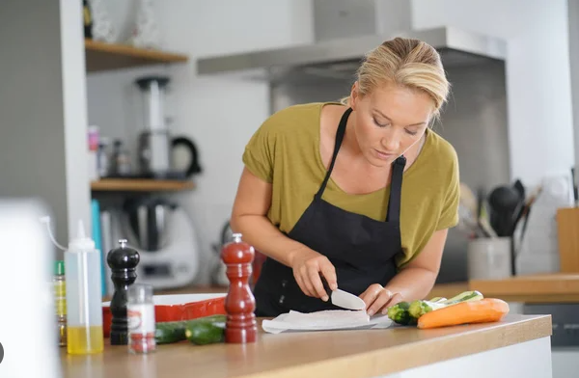
Persona 3
Profile:
Emily is a dedicated stay-at-home mom who prioritizes providing healthy meals for her family. She wants to reduce food waste and find creative ways to incorporate vegetables into her family's diet. Interests:
Emily is passionate about cooking and enjoys finding new recipes to try. She is interested in nutrition and wants to ensure that her family eats balanced meals that are both healthy and delicious.
Frustration:
Emily is frustrated by the challenge of finding new and exciting recipes that her family will enjoy. She often feels guilty about wasting food and wants to find ways to reduce food waste in her household. Goals:
Emily's goal is to find a tool that can help her plan healthy and balanced meals for her family while also reducing food waste. She wants an app that can suggest creative recipes based on the ingredients she has in her pantry, making mealtime both nutritious and enjoyable for her family.
Name: Emily Age: 35 Occupation: Stay-at-Home Mom

Slide 12

Minimal Viable Product (MVP)

Slide 13
Minimal Viable Product (MVP)
The following are the features that we are covering in our MVP:
Login Screen
Sign in
Home Page
Camera screen
Profile Screen
History

Slide 14
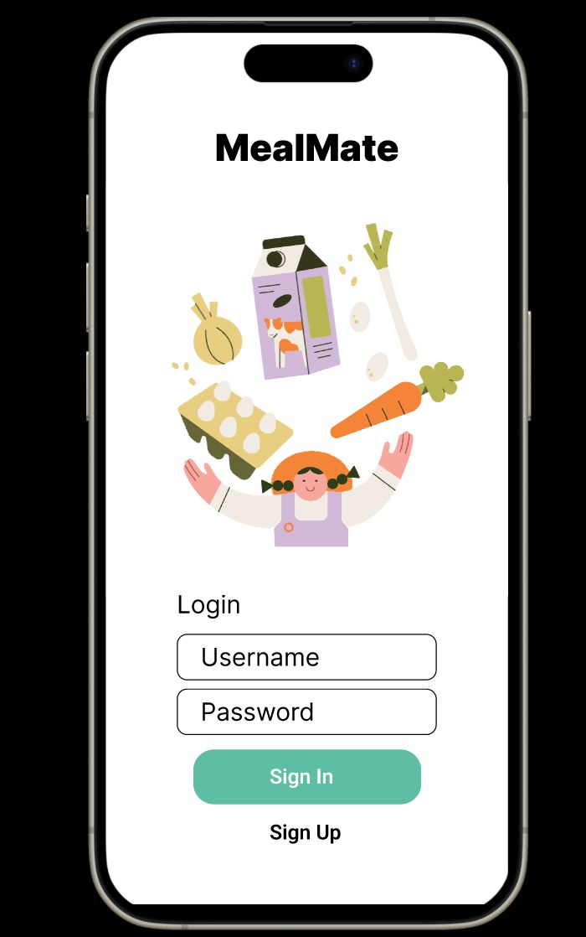
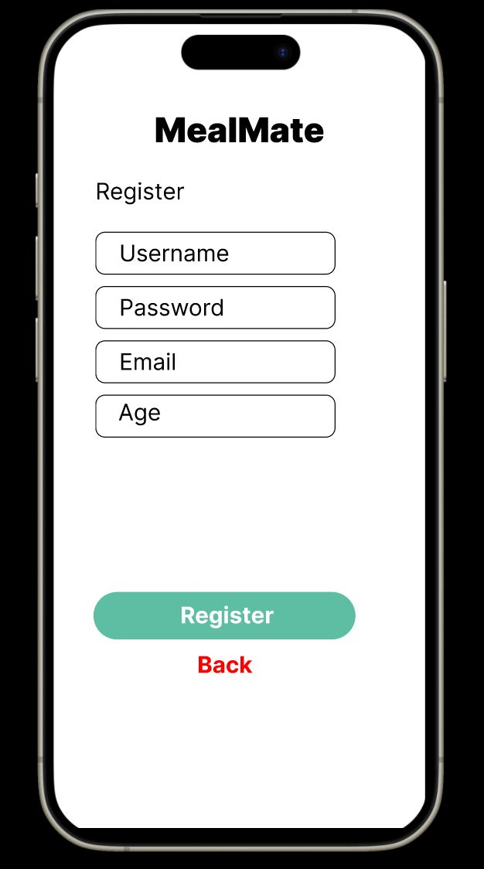
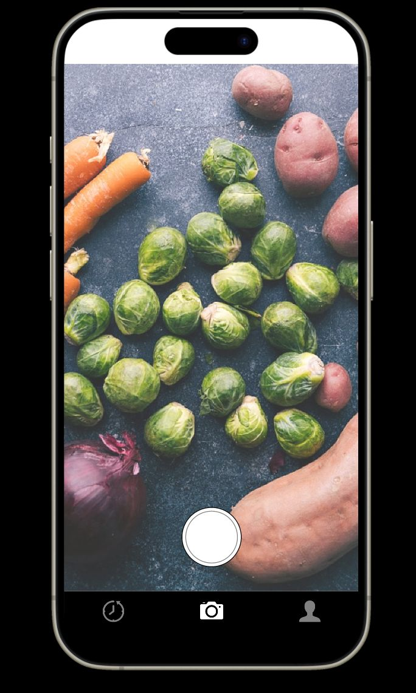
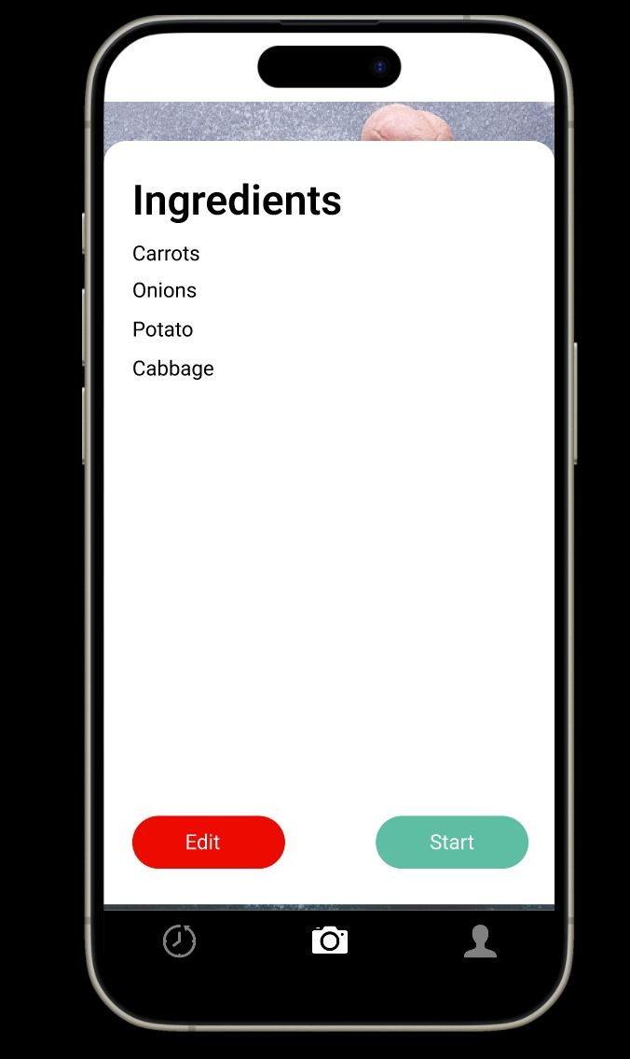
Minimal Viable Product (MVP)

Slide 15
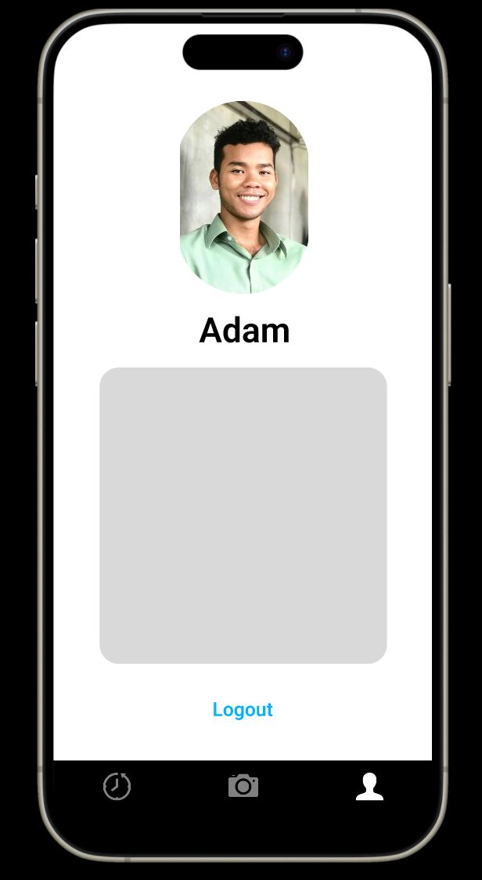
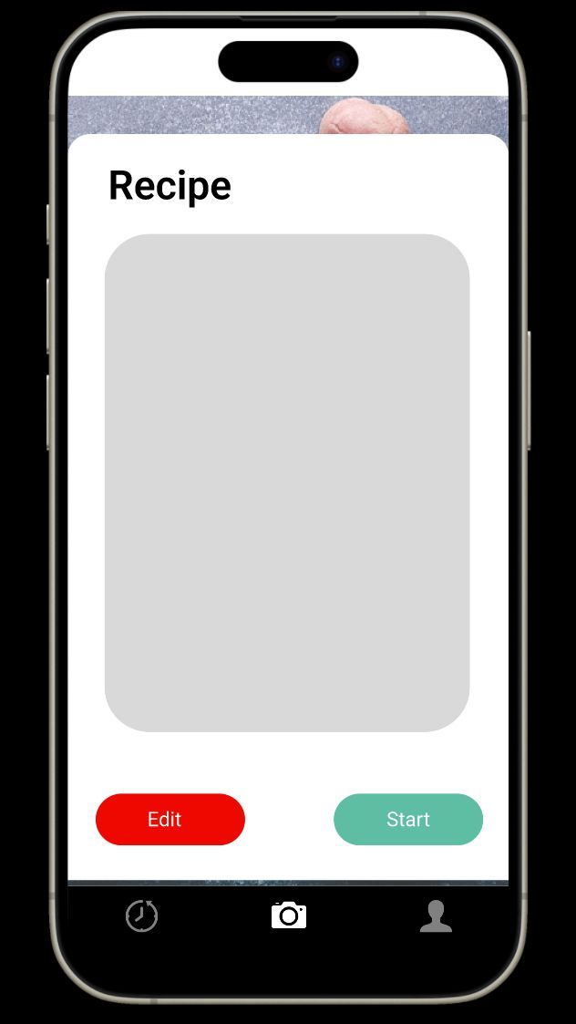
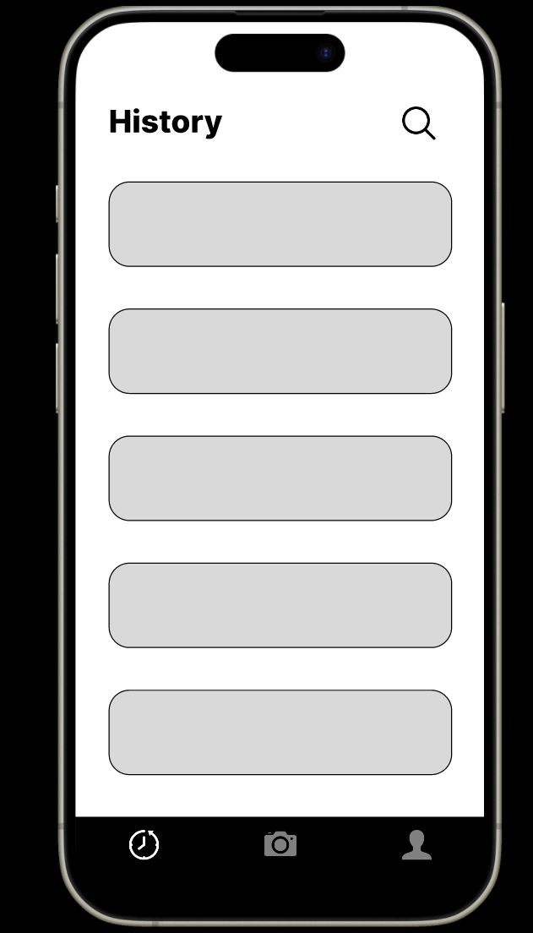
Minimal Viable Product (MVP)

Slide 16
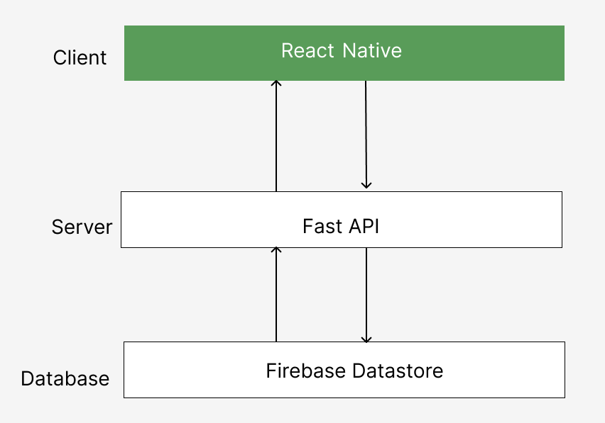
Technologies
React Native
Python
FastAPI
Firebase Datastore
ChatGPT API
Git/Github
JIRA

Slide 17
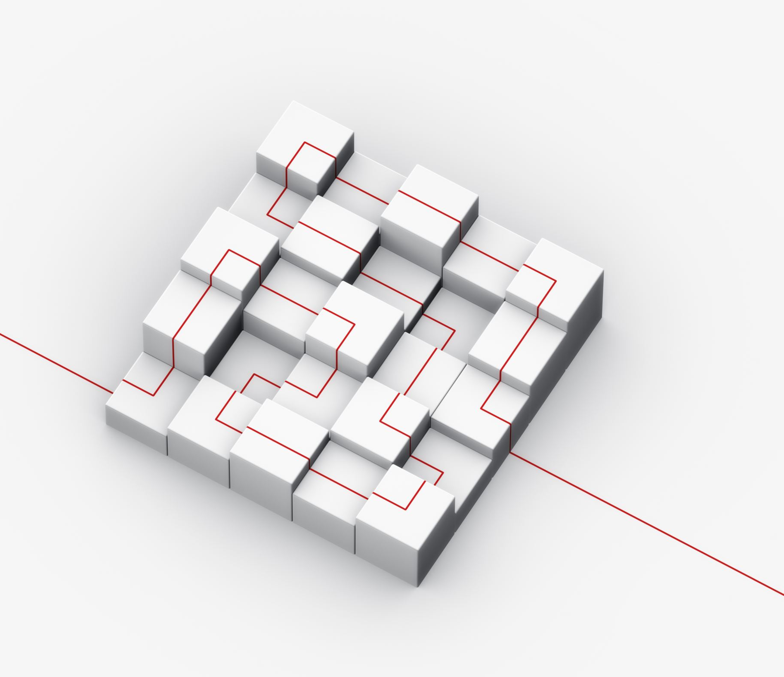
Architecture Diagram

Slide 18
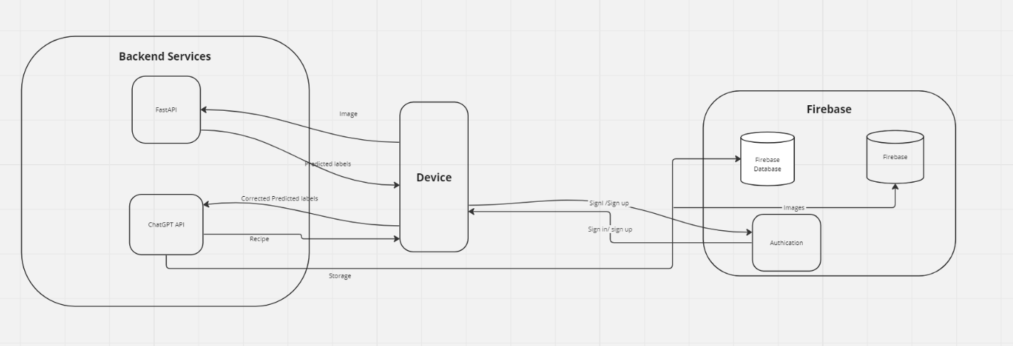
Conceptual Architecture Diagram

Slide 19
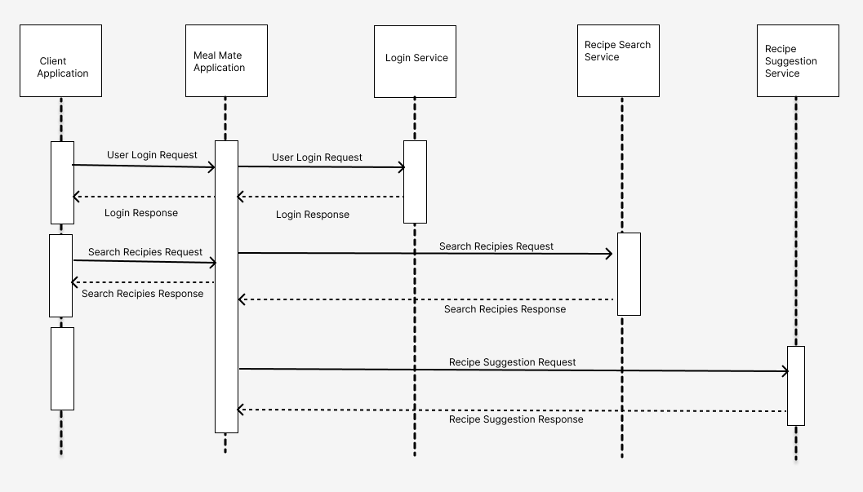
Sequence Architecture Diagram

Slide 20
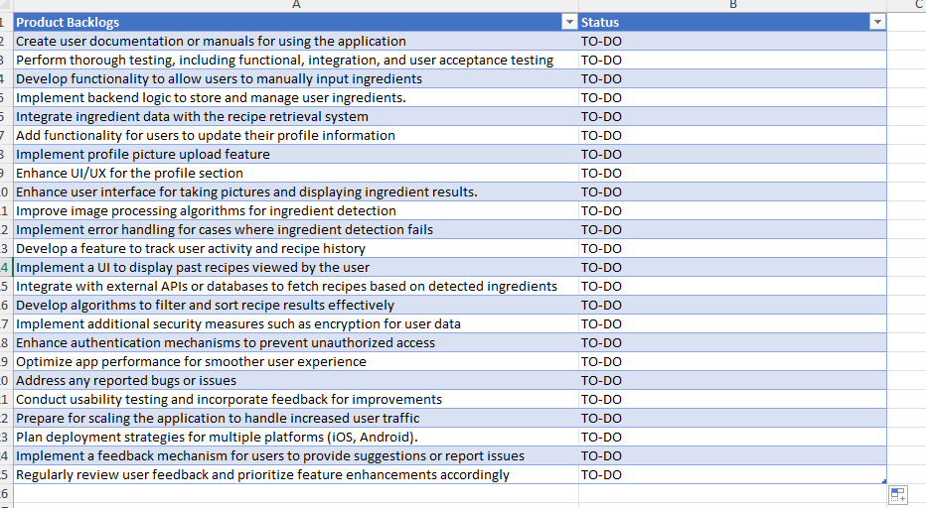
Product backlog

Slide 21
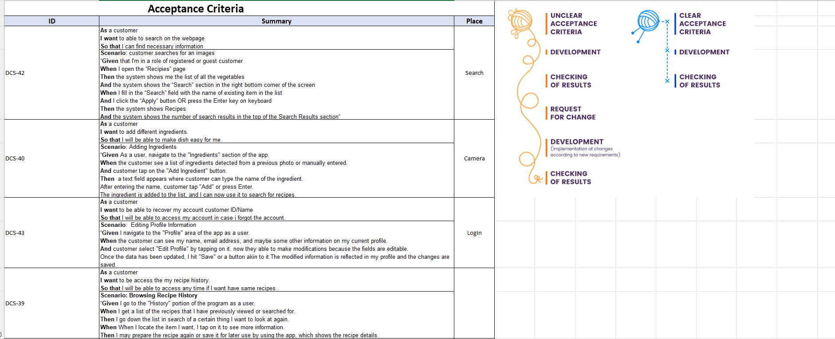
Acceptance Criteria & User stories

Slide 22
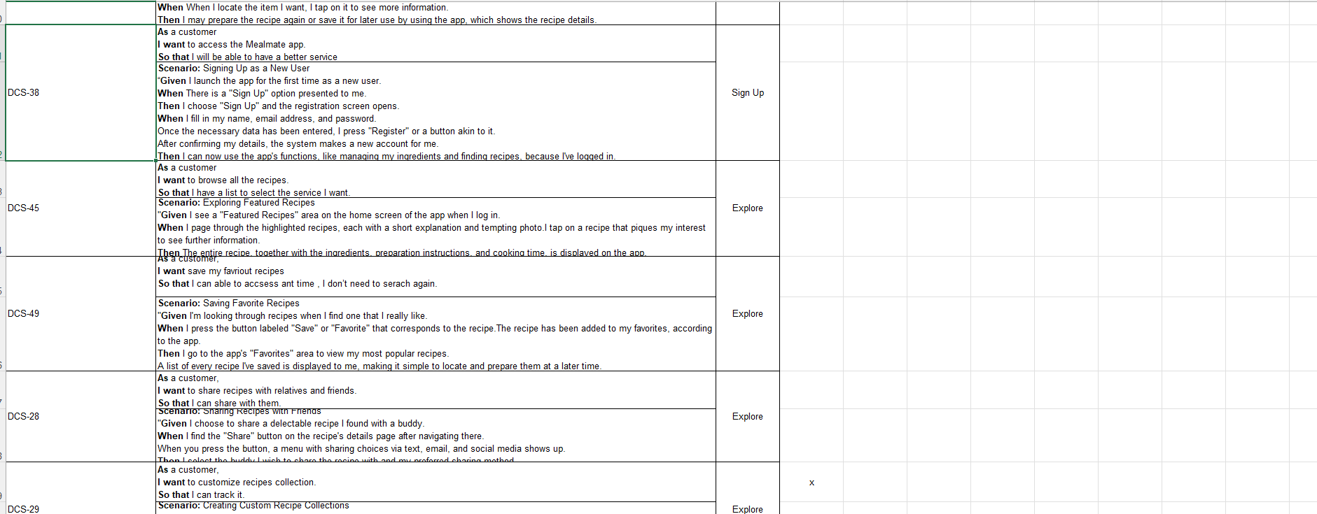
Acceptance Criteria & User stories

Slide 23
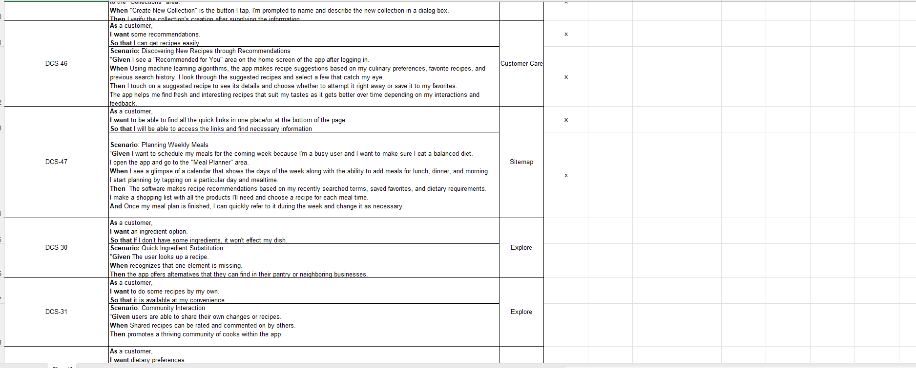
Acceptance Criteria & User stories

Slide 24
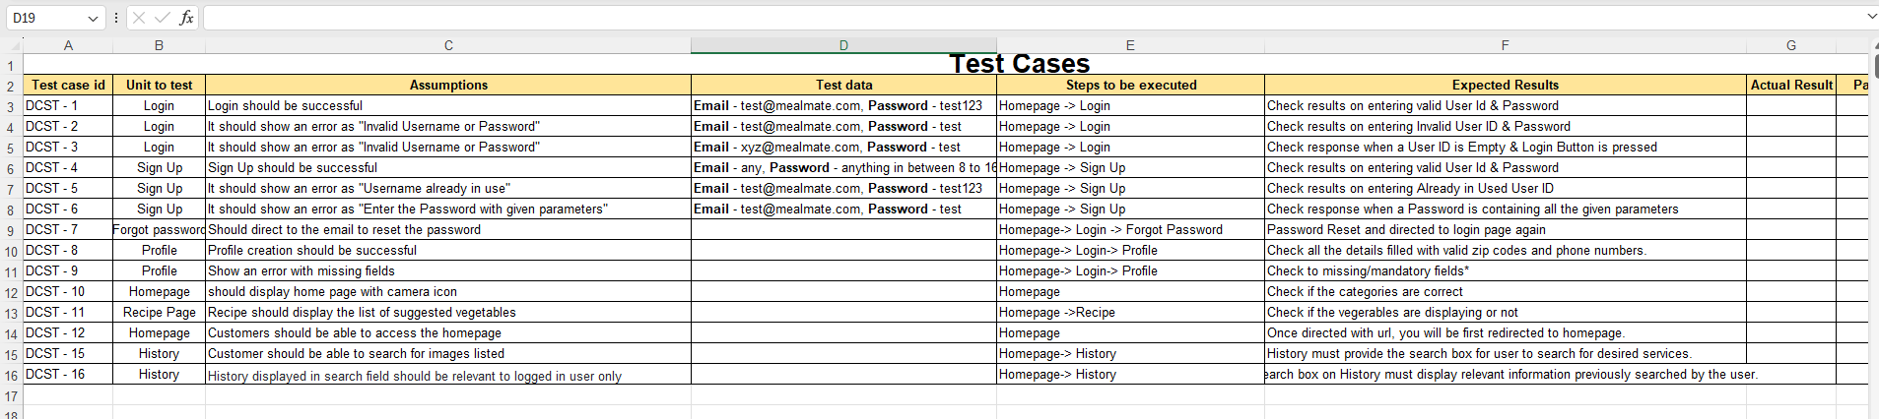
Test Cases

Slide 25

Sprint Backlog

Slide 26
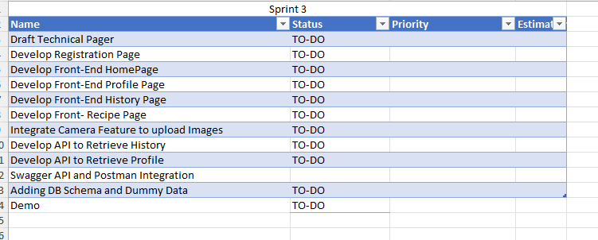
Sprint Backlog

Slide 27
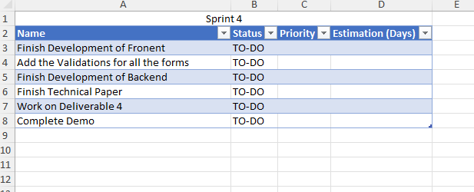
Sprint Backlog

Slide 28
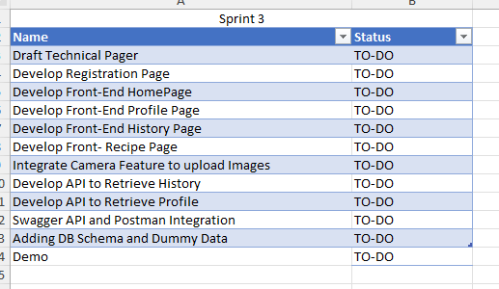
Sprint 3 tasks

Slide 29
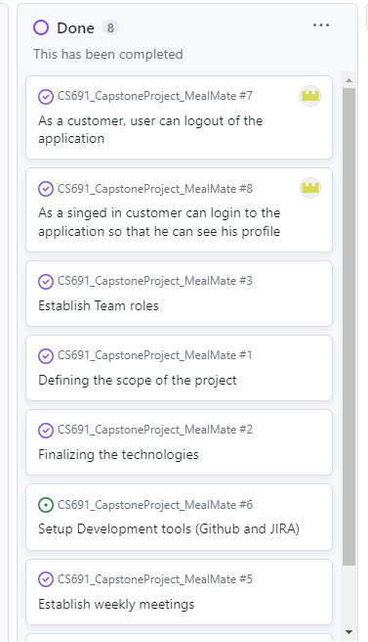
Stories Completed

Slide 30

Retrospective

Slide 31

What Went Well
Because of Slack, we are able to communicate well be connected
Teamwork helped in requirement gathering.
We have listed down the technologies which will be used. Although we still need to learn the concepts in depth to be able to make a good product.
Sprint Backlog

Slide 32
What need improvements
Meeting schedules have to be planned carefully.
Team participation requires a slight improvement.
Sprint Backlog

Slide 33
Next Steps
Proper availability of time needs to be discussed.
Get a clear idea of deadlines to finish the tasks as per schedule.
Start working on the activities assigned.

Slide 34

Project Demo Sprint 2

Slide 35
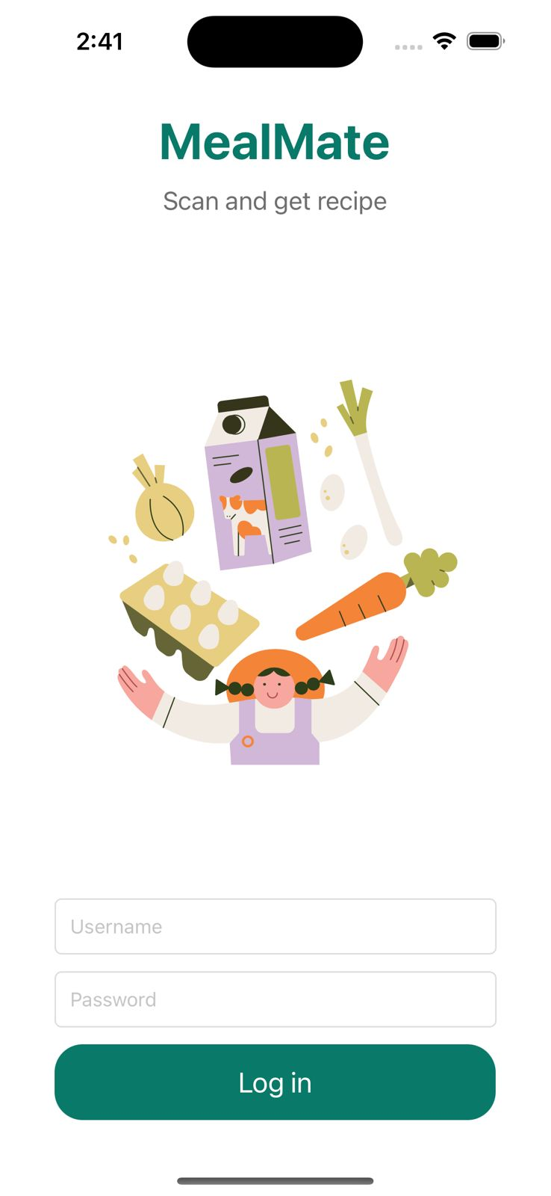
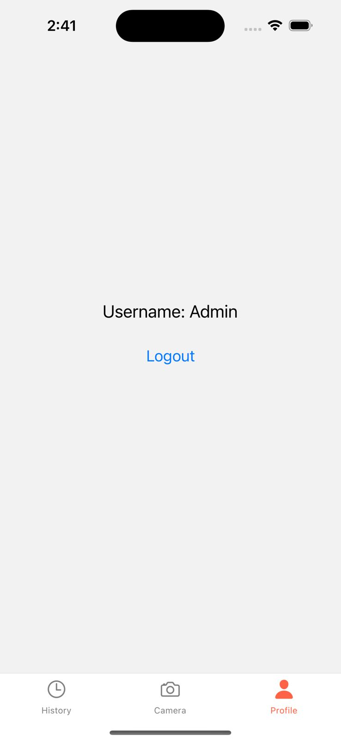
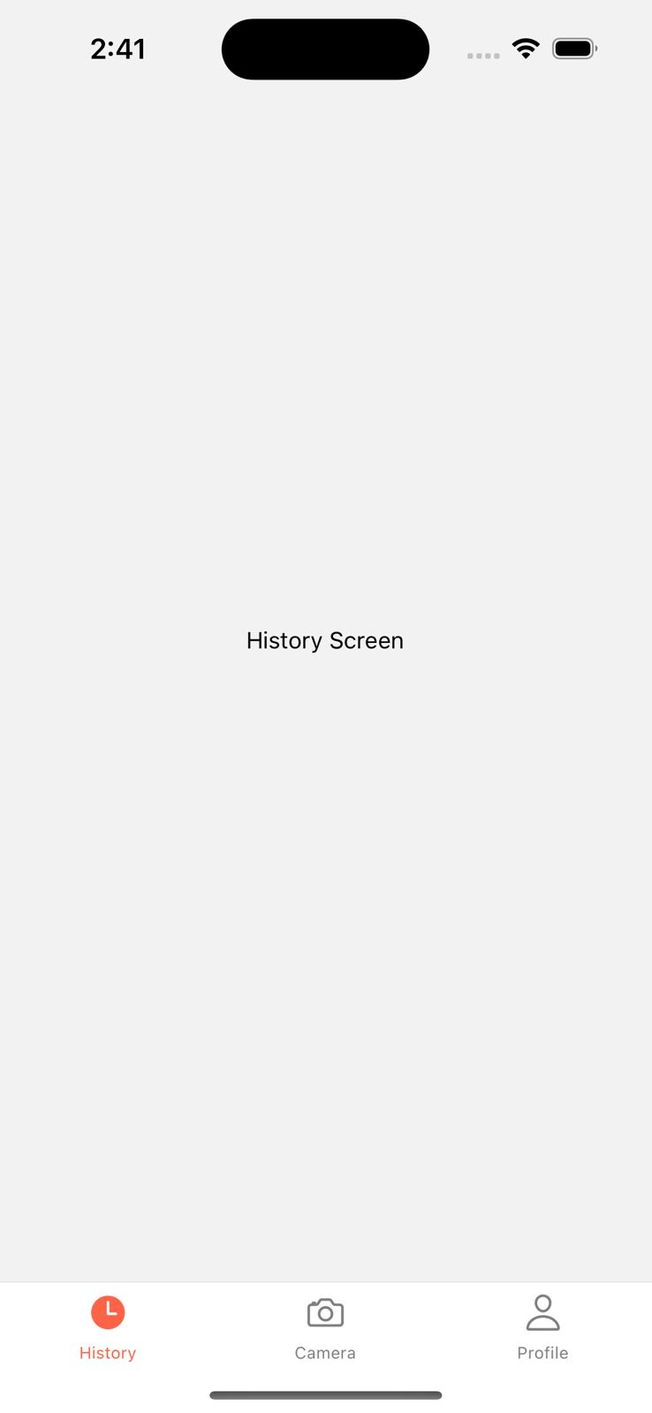

Slide 36
Wiki page Link
https://github.com/upadristasarath/CS691_CapstoneProject_MealMate/wiki

Slide 37
Thank you

